Slide 1
Guidelines
Kindly use the given template for submitting your prototype(Make a copy of the template)
One team is only required to submit one project.
Follow this template while preparing your presentation.
You are welcome to add as many POCs and design concepts to support your project.
The project should be feasible and the team members should be capable enough, to come up with the fully functioning prototype of the same idea, if required.
In case of queries, kindly reach out to us at solutionchallengesupport@hack2skill.com
Note: Prototype must include cloud deployment and use at least one Google AI model or service (e.g., Gemini) as part of the solution.

Slide 2


Team Details
Team name: Tech Nova
Team leader name: Vasamsetti Jahnavi Devi
Problem Statement: Users struggle to find the best deals across multiple e-commerce platforms, leading to time wastage and missed savings.

Slide 3
Brief about your solution
a. How different is it from existing ideas?
Unlike traditional price comparison websites, our solution uses AI to:
Suggest the best product based on user preferences
Provide smart recommendations (not just prices)
Display a clean, modern UI with images instead of text-heavy listings

Slide 4
b. How will it solve the problem?
Aggregates product data from multiple platforms
Compares prices instantly
Uses AI to recommend the best value product
Saves user time and improves decision-making

Slide 5
c. USP (Unique Selling Proposition):
AI-powered smart suggestions
User-friendly modern interface
Fast real-time comparison
Personalized recommendations

Slide 6
List of features offered by the solution
Product search functionality
Price comparison across platforms
AI-based product recommendations
Image-based product display UI
Responsive design (mobile + desktop)
Simple and fast navigation

Slide 7
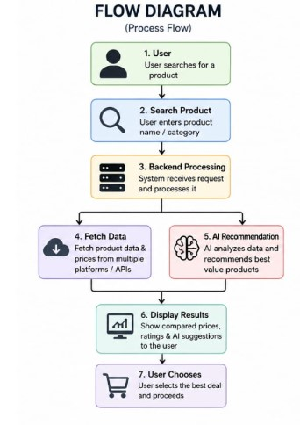
Process flow diagram or Use-case diagram
User
⬇️
Search Product
⬇️
Backend Processing
⬇️
Fetch Data
⬇️
AI Suggestion
⬇️
Display Results
⬇️
User Chooses
⬇️
Best Deal

Slide 8
Wireframes/Mock diagrams of the proposed solution (optional)
Home Page (Search bar + trending products)
Results Page (Product cards with price comparison)
AI Suggestions Section

Slide 9
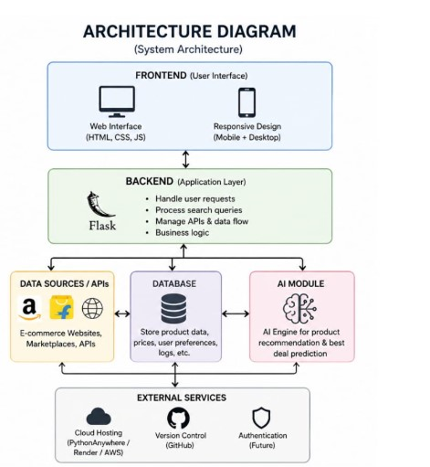
Architecture diagram of the proposed solution
Frontend (HTML, CSS, JS)
↓
Backend (Python Flask)
↓
API / Data Source
↓
AI Module (for recommendations)

Slide 10
Technologies to be used in the solution
Frontend: HTML, CSS, JavaScript
Backend: Python (Flask)
Version Control: GitHub
AI Integration: OpenAI API / logic-based AI
Deployment: PythonAnywhere / GitHub

Slide 11
Estimated implementation cost (optional)
Free (student tools)
API cost: minimal
Hosting: free tier

Slide 12
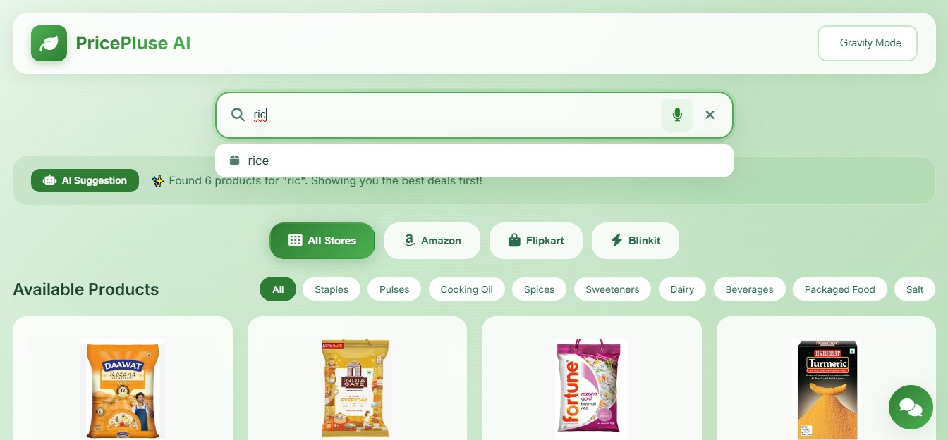
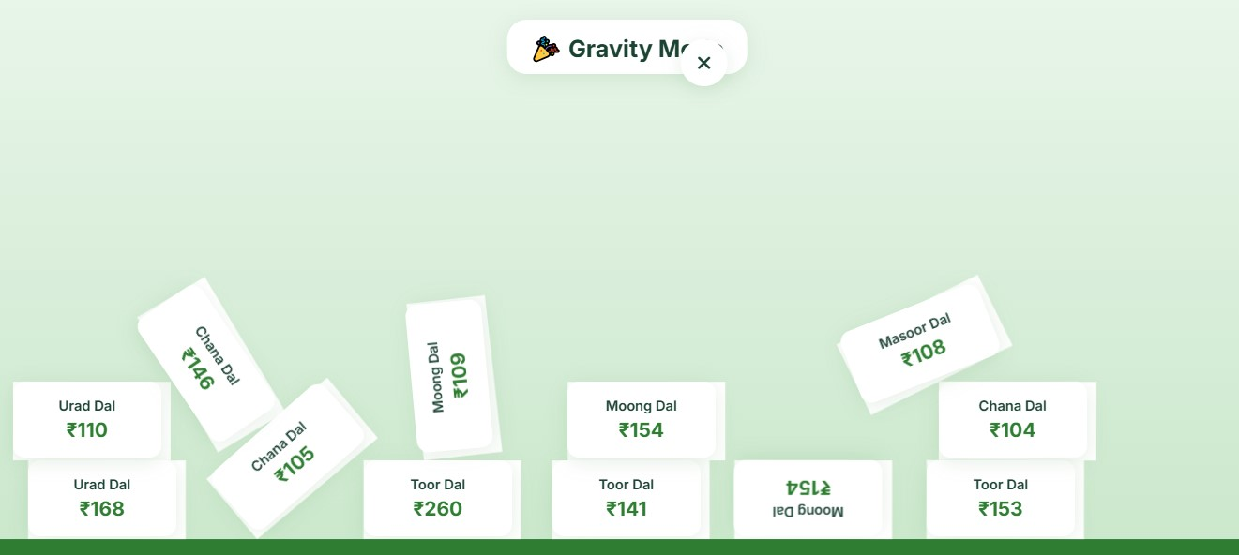
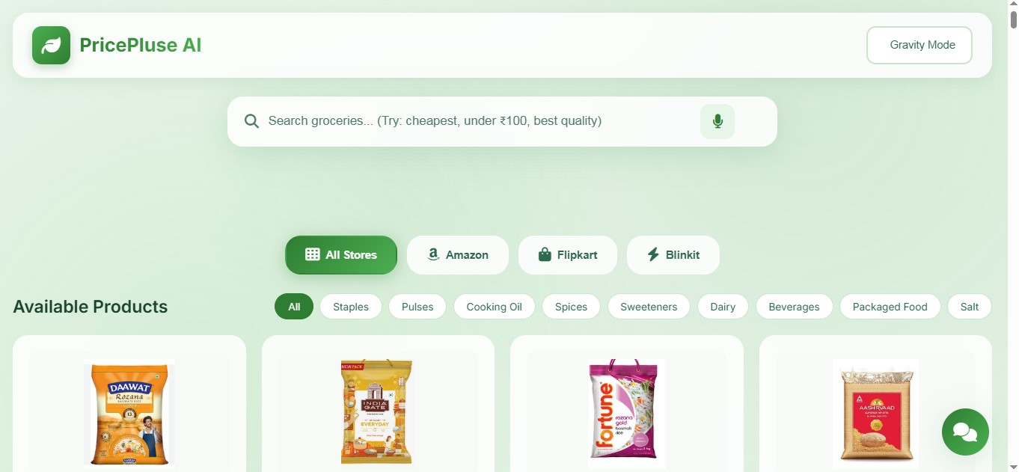
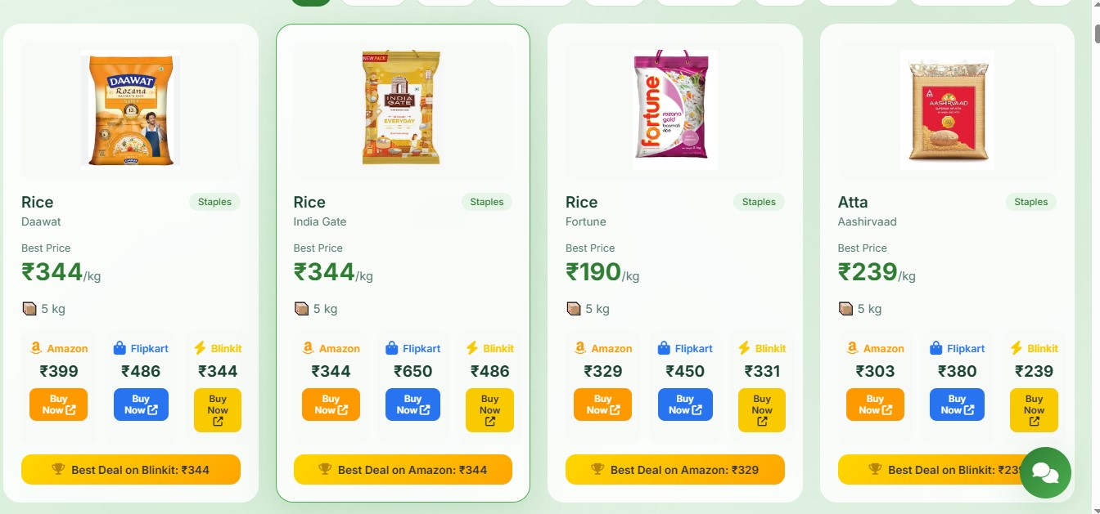
Snapshots of the MVP

Slide 13
Additional Details/Future Development (if any)
Add real-time API integrations (Amazon, Flipkart, etc.)
Improve AI recommendations
Add user login & personalization
Mobile app version

Slide 14
Provide links to your:
GitHub Public Repository (https://25a31a05et-ops.github.io/pricepulse-AI/)
Demo Video Link (3 Minutes)
MVP Link (https://pricepulse-ai.onrender.com/)
Working Prototype Link (https://pricepulse-ai.onrender.com/)

Slide 15


